Slide 1
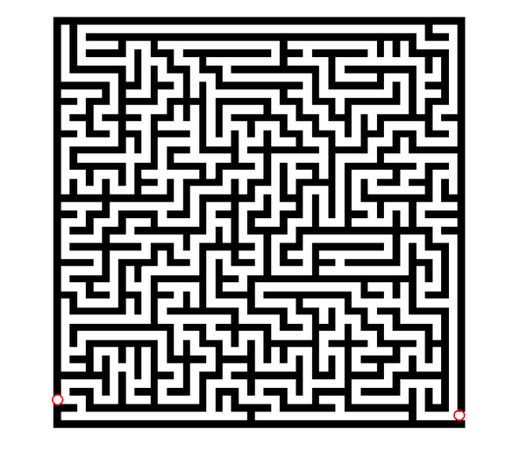
LECTURE: 5
PROBLEM SPACE AND SEARCH
How will you solve this?

Slide 2
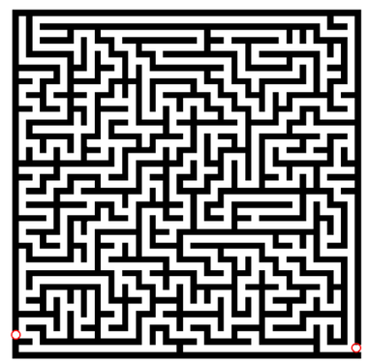
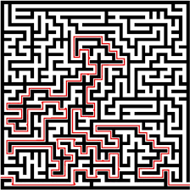
SOLVED:
START
END
START
END

Slide 3
What is Problems in AI?
Problem is a particular task
that calls for
Decision-making or solution-finding

Slide 4
Components of Problems in AI:
Initial State: The problem's starting condition.
Goal State: The desired outcome or solution.
Operators: Actions to transition between states.
Restrictions: Rules or constraints for solving the problem.

Slide 5
Example: Chess Game
Initial State: Starting positions of all chess pieces.
Objective State: Achieving checkmate.
Operators: Permissible moves for each piece.
Constraints: Rules governing chess gameplay.

Slide 6
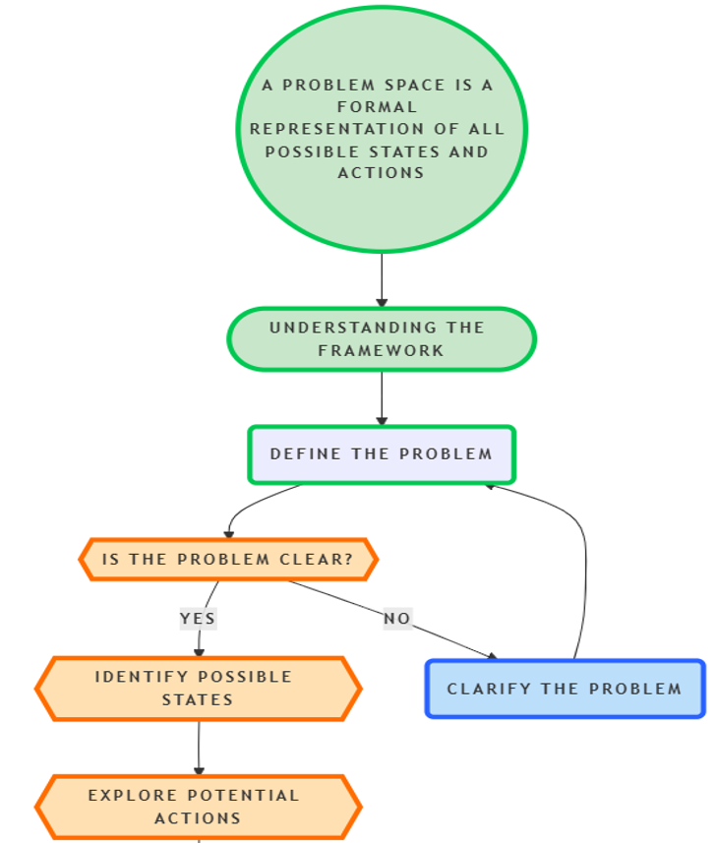
Problem Space:

Slide 7
Problem Formulation by State Space Search
1. State space formally defines problem structure.
2. Graph ( V, E) represents state space.
3. Nodes ( V) correspond to problem states.
4. Arcs (E) represent applicable actions.
5. Directed arcs connect parent and child nodes.
6. Parent precedes, child succeeds in graph.

Slide 8
Components of Problem Spaces:
States: Possible scenarios within the problem.
State Space: All reachable states from start.
Paths: Connections between states via operators.

Slide 9
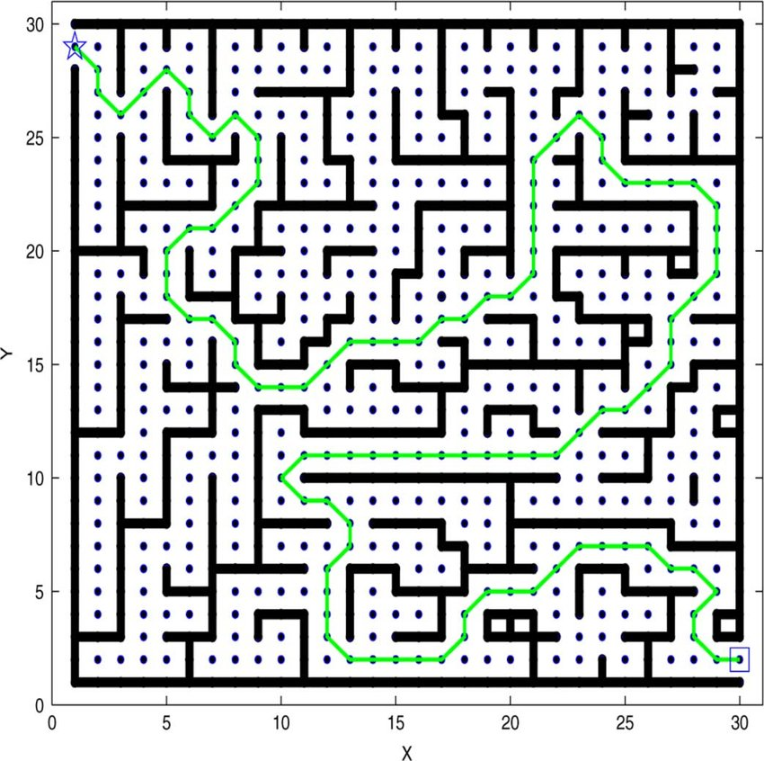
Example 1: Maze-Solving Problem
START
State Space: The maze structure itself.
States: All possible positions in the maze.
Paths: Routes connecting start to the exit.
END

Slide 10
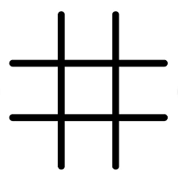
Example 2– Tic-Tac-Toe
Approach 1 (Table Based)
Approach 2- Uses three sub procedures:
Make 2
Posswin(p)
Go(n)
Approach 3 (Magic Square)

Slide 11
Example 3: Water Jug Problem

Slide 12
Search in AI:
Definition: Process of finding problem solutions.
Purpose: Identify solutions meeting constraints and goals.
Method: Systematically traverse the problem domain.

Slide 13
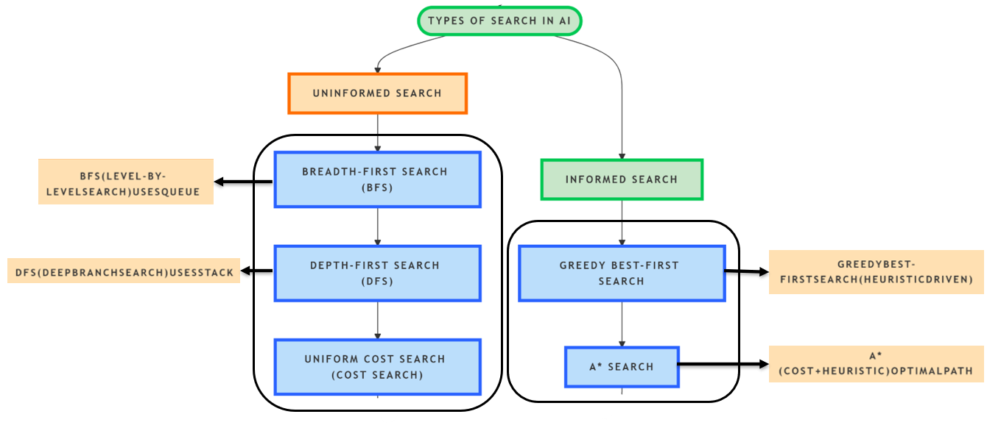
Types of Search in AI:

Slide 14

Next: Mapping Minds with State Space!

